Slide 1
Uncovering St. Pete's Unique Business Mix
Digital Learning Ecosystem

Slide 2





Group 3 - Team members
Meghanjali CH Sai Pavan B Durga Mohan B Surendra M Mohammed Afeef

Slide 3
Business Problem Statement
Analyze the industry mix/diversity on each commercial corridor in 2023
What is the industry mix/diversity on each commercial corridor? (Individual analysis for each corridor).

Slide 4
Data set details
City of St. Petersburg. "Business Tax ID Data for Properties on Commercial Corridors within the South St. Petersburg CRA." St. Pete Economic Development, Community Redevelopment Areas. Accessed [2023], https://www.stpete.org/business/economic_development/community_redevelopment_areas.php

Slide 5

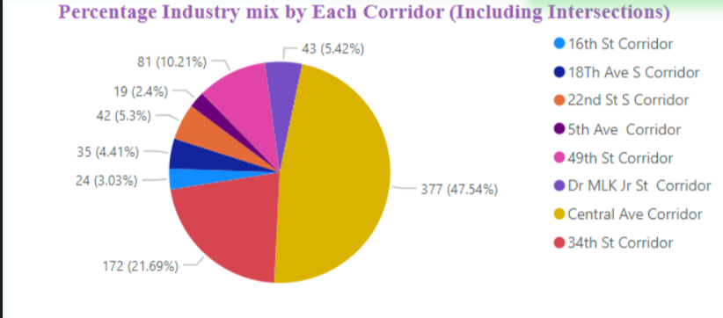
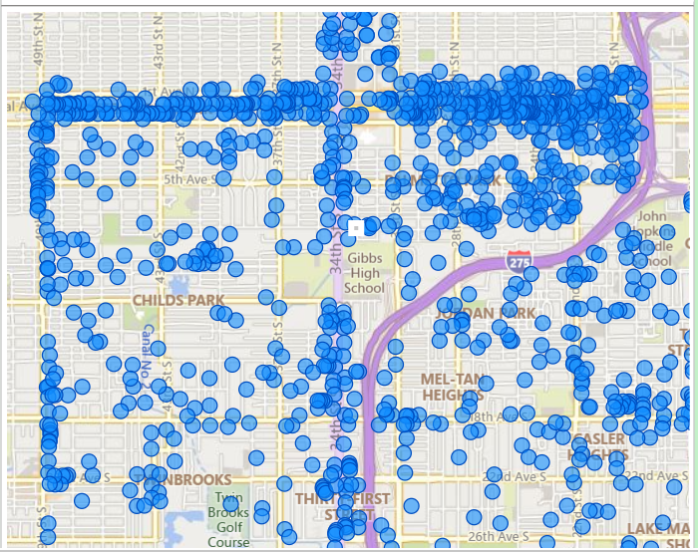
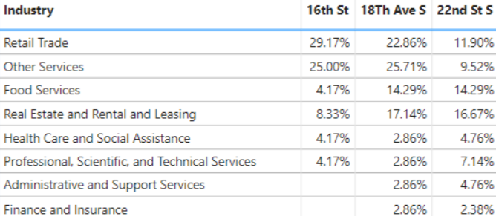
Uncovering St. Pete's Unique Business Mix
Durga Mohan Bathula, Sai Pavan Banala, Meghanjali Chennupati,
Mohammed Afeef Shaik, Surendra Maddipati
School of Information and Systems Management
Enterprise Information Systems Management – ISM6155
Introduction
Results and Discussion
Conclusions
Cities are dynamic and diverse ecosystems with businesses of all sizes playing an important role in economic growth and employment creation. The distribution of business across different regions in a city can provide useful insights about the diversity of the businesses and most importantly the economic growth created by all those individual businesses.
In this project, we are focusing on St. Petersburg, which is a city on the Florida’s gulf coast and part of the Tampa Bay area. St. Pete is a lively city with a range and variety of businesses and sectors. Our goal is to examine the diversity of businesses that exist in the city’s eight corridors and provide a detailed assessment of the commercial landscape of those eight corridors. We map the distribution of these businesses by the type of the sector and location using data analysis and visualization techniques and identifying various patterns which may help new investors or entrepreneurs to establish businesses.
This analysis highlights the distinct characteristics of each corridor. This research of ours aims identify the potential opportunities of growth , innovation and investment.
For this project we used Power BI, a powerful data visualization tool. It provides a wide range of tools and methods for visualizing the data, by which we can several gain insights for the data provided. Our goal is get the percentage of all the businesses in a particular corridor, we used several techniques in Power BI to extract this information from the dataset provided.
Our analysis of the business dataset of the eight corridors reveals a complex and diverse economic landscape. By combining the data analysis and visualization techniques in Power BI we are able to gain valuable insights regarding the businesses.
Observations:
Central Avenue Corridor has the highest number of businesses, 377 which is 47.54% of all the businesses.
Retail Trade has the highest number of businesses with 18.79%. The majority of the retail trade businesses are in Central Avenue Corridor.
The dataset shows the businesses in the intersections for both corridors. This gets a count of 793 businesses in total. But the number of unique businesses is 749
Information industry has the lowest number of businesses with 0.38% which is 3.
5th Avenue corridor has the lowest number of businesses with 19, which is 2.4% of all the businesses,
Recommendations:
Central Avenue Corridor being the biggest business hub, can be a good place for investment in new businesses, which do not have their presence in the corridor. Industries like Manufacturing, Accommodation, and Information can be good sectors to invest in.
With the lowest number of businesses, the Information industry might be facing lesser competition than usual. This shows that Information can be a good industry to invest in.
Figure 1. The chart which shows the number of businesses in different corridors
From the two dashboards created we extracted many insights regarding the businesses in the corridors. The first dashboard , which contains a pie chart (Figure 1) shows the total number of corridors in a particular corridor. We observed from the chart that majority number of businesses are located in Central Avenue Corridor, which makes it the biggest business hub. This indicates major competition in that corridor, which makes new businesses struggle to establish and run successfully. By selecting the kind of industry the chart changes dynamically and shows the percentage of the selected industry present in the corridors. The map (Figure 2) shows the exact location of the business when selected in the business drop-down from the dashboard. The table(Figure 3) shows the percentage of a kind of industry in a corridor. By using this table we can observe which kind of industry is dominating in a corridor, this helps new entrepreneurs to plan their investments in new businesses which are less in number in a corridor. The figure is just a small snippet from a bigger table with more data relating to every corridor. The data in the columns can be sorted which business is more and which is less dominant in a specific corridor.
Methods
Importing the dataset into Power BI
The obtained dataset is pre-processed and cleaned by deleting duplicates using python. All the duplicates and null values were removed from the dataset before importing it into the Power BI environment.
Visualizing using Power BI
Using the column and row data in the dataset, two dashboards are created in Power BI.
The First Dashboard is an interactive dashboard with the ability to apply several filters to visualize the data. The total percentage of the kinds of industries in all the corridors is shown using a pie chart. Additionally, a map of these corridors which highlights the location of the businesses in the corridors is displayed. The second dashboard, contains a table which shows the percentage of mix of businesses in a particular corridor. The data in the columns can be sorted in order to see which business is leading in a specific corridor.
References
City of St. Petersburg. "Business Tax ID Data for Properties on Commercial Corridors within the South St. Petersburg CRA." St. Pete Economic Development, Community Redevelopment Areas. Accessed [2023], https://www.stpete.org/business/economic_development/community_redevelopment_areas.php.
Dashboard Link
https://app.powerbi.com/groups/me/reports/7e92d94d-3365-41a7-90a9-dda92663275d/ReportSection?ctid=741bf7de-e2e5-46df-8d67-82607df9deaa
Figure 2. A map showing the locations of all the businesses in the eight corridors
Figure 3. A snippet of the table which shows the percentages of different kinds of industries in each corridor

Slide 6
Analysis
Central Avenue Corridor being the biggest business hub, it can be good place for investment in new businesses, which does not have their presence in the corridor. Industries like Manufacturing, Accommodation and Information can be good sectors to invest.
With the lowest number of businesses , the Information industry might be facing lesser competition than usual. This shows that Information can be a good industry to invest in.

Slide 7
Link to dashboard
Click to view the Dashboard

Slide 8
THE END
Digital Learning Ecosystem

